Slide 1
Data Platform and AI for Precision Farming
Soil Moisture Modeling and Assessment as a Case Study

Slide 2

whoami
Matteo Francia
Email: m.francia@unibo.it
Research fellow @ UniBO
Research topics
Spatio-temporal analytics
Big data platforms
Website
https://big.csr.unibo.it/

Slide 3
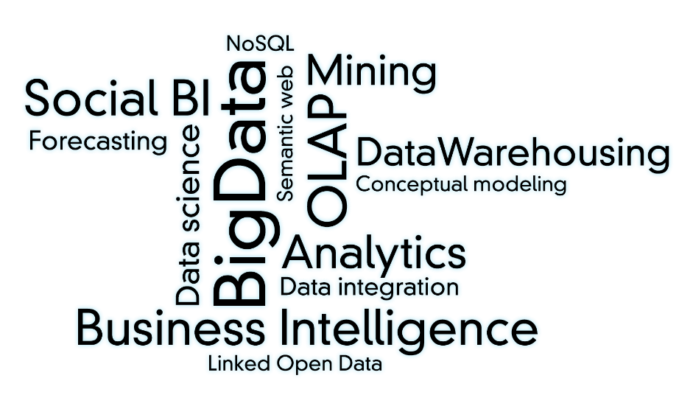
The Business Intelligence Group
The Business Intelligence Group carries out researches on methodologies, techniques and technologies in the field of data analysis
Industry 4.0
Big Data Analytics
Social BI
Big Data
DW optimization
Data Mining
DW Design

Slide 4
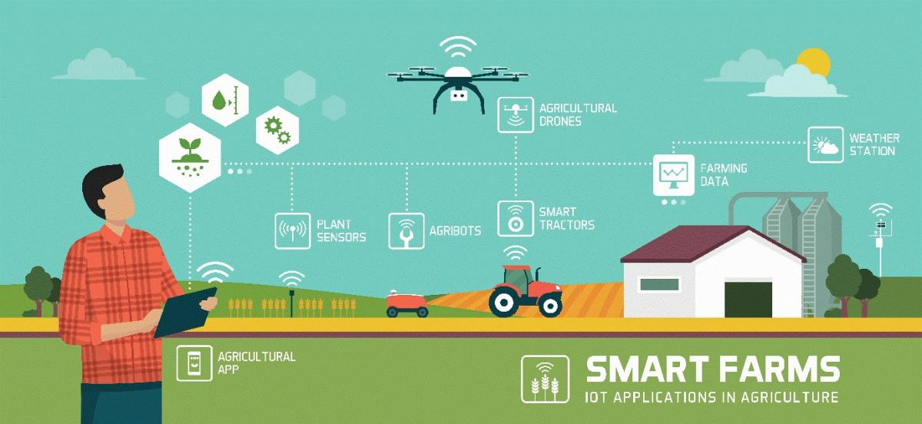
Roadmap
Introduction to Data Platforms
Soil Moisture Modeling and Assessment as a Case Study

Slide 5
Acknowledgments
Part of this talk is the result of a joint work
DISI @ UniBO --- Department of Computer Science and Engineering
Prof. Matteo Golfarelli
Dr. Matteo Francia
Dr. Joseph Giovanelli
DISTAL @ UniBO --- Department of Agricultural and Food Sciences
Prof. Moreno Toselli

Slide 6
How did we get here?
Data-Driven Innovation
Use of data and analytics to foster new products, processes and markets
Drive discovery and execution of innovation, achieving new services with a business value
Analytics
A catch-all term for different business intelligence (BI)- and application-related initiatives
E.g., of analyzing information from a particular domain
E.g., applying BI capabilities to a specific content area (e.g., sales, service, supply chain)
Advanced Analytics
(Semi-)Autonomous examination of data to discover deeper insights, make predictions, or generate recommendations (e.g., through data/text mining and machine learning)
https://www.gartner.com/en/information-technology/glossary (accessed 2022-08-01)

Slide 7
Towards a unifying data platform
Data-driven company refers to companies where decisions and processes are supported by data
Decisions are based on quantitative rather than qualitative knowledge
Processes & Knowledge are an asset of the company and are not lost if managers change
The gap between a data-driven decision and a good decision is a good manager
Adopting a data-driven mindset goes far beyond adopting a business intelligence solution and entails:
Create a data culture
Change the mindset of managers
Change processes
Improve the quality of all the data

Slide 8
Towards a unifying data platform
Digitalization is a journey that involves three main dimensions. Moving from A to B is a multi-year process made of intermediate goals, each of which must be feasible:
Solves a company pain and brings value
Can be accomplished in a limited time range (typically less than one year)
Costs must be economically related to gains
Are processes extensively digitalized and produces reliable data?
Technological infrastructure
B
Data quality
& quantity
Do we have the right persons to drive the project and exploit the results?
Is the technogical infrastructure appropriate to support data collection and analysis?
A
Digital culture

Slide 9
Reference scenario
Companies are collecting tons of data to enable advanced analytics
Raw data are difficult to obtain and more and more heterogeneous and complex
… making harder their collection, integration, transformation, and maintenance
There is a need for describing/curating the data to make them consumable
Assuming we got the data, where are we collecting and processing data?
Getting value from data is not only a matter of storage
Need integrated and multilevel analytical skills and techniques

Slide 10
Reference scenario
Our focus
(Un)Structured big-data batch
(Un)Structured big-data streams
Small
Volume
Structured
Big
Variety
(data model)
Batch
Stream
Unstructured
High
Velocity
Low
(pull)
(
(
push
latency
)
)

Slide 11
Data platform
Database
"A database is a structured and persistent collection of information about some aspect of the real world organized and stored in a way that facilitates efficient retrieval and modification. The structure of a database is determined by an abstract data model. Primarily, it is this structure that differentiates a database from a data file. The most popular data model is relational that represents data as a set of tables."
Data Warehouse
"A collection of data that supports decision-making processes. It provides the following features: subject-oriented, integrated and consistent, not volatile."
Özsu M.T. (2018) Database. In: Encyclopedia of Database Systems. Springer, New York, NY. https://doi.org/10.1007/978-1-4614-8265-9_80734 Matteo Golfarelli and Stefano Rizzi. Data warehouse design: Modern principles and methodologies. McGraw-Hill, Inc., 2009.

Slide 12
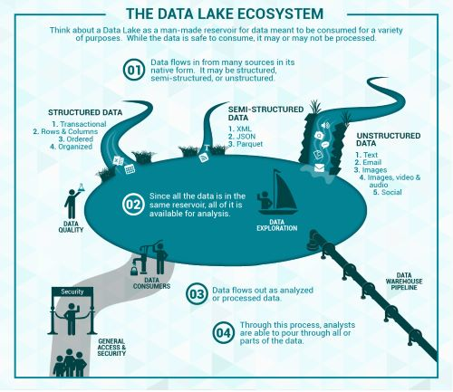
Data platform
Data lake
Couto et al.: “A DL is a central repository system for storage, processing, and analysis of raw data, in which the data is kept in its original format and is processed to be queried only when needed. It can store a varied amount of formats in big data ecosystems, from unstructured, semi-structured, to structured data sources”
Couto, Julia, et al. "A Mapping Study about Data Lakes: An Improved Definition and Possible Architectures." SEKE. 2019. https://dunnsolutions.com/business-analytics/big-data-analytics/data-lake-consulting

Slide 13
Data platform
Data lakes have increasingly taken the role of data hubs
Eliminate up-front costs of ingestion and ETL since data are stored in original format
Once in DL, data are available for analysis by everyone in the organization
Drawing a sharp line been storage/processing/serving is hard
Is a database just storage?
What about SQL/OLAP?
Blurring of the architectural borderlines
DL is often replaced by “data platform” or “data ecosystem”
Encompass systems supporting data-intensive storage, computation, analysis

Slide 14
Data platform
Data platform
An integrated set of technologies that collectively meets an organization’s end-to-end data needs such as acquisition, storage, preparation, delivery, and governance, as well as a security layer for users and applications
Rationale: relieve users from complexity of administration and provision
Not only technological skills, but also privacy, access control, etc.
Users should only focus on functional aspects

Slide 15

Modeling data pipelines
Shearer, Colin. "The CRISP-DM model: the new blueprint for data mining." Journal of data warehousing 5.4 (2000): 13-22.

Slide 16
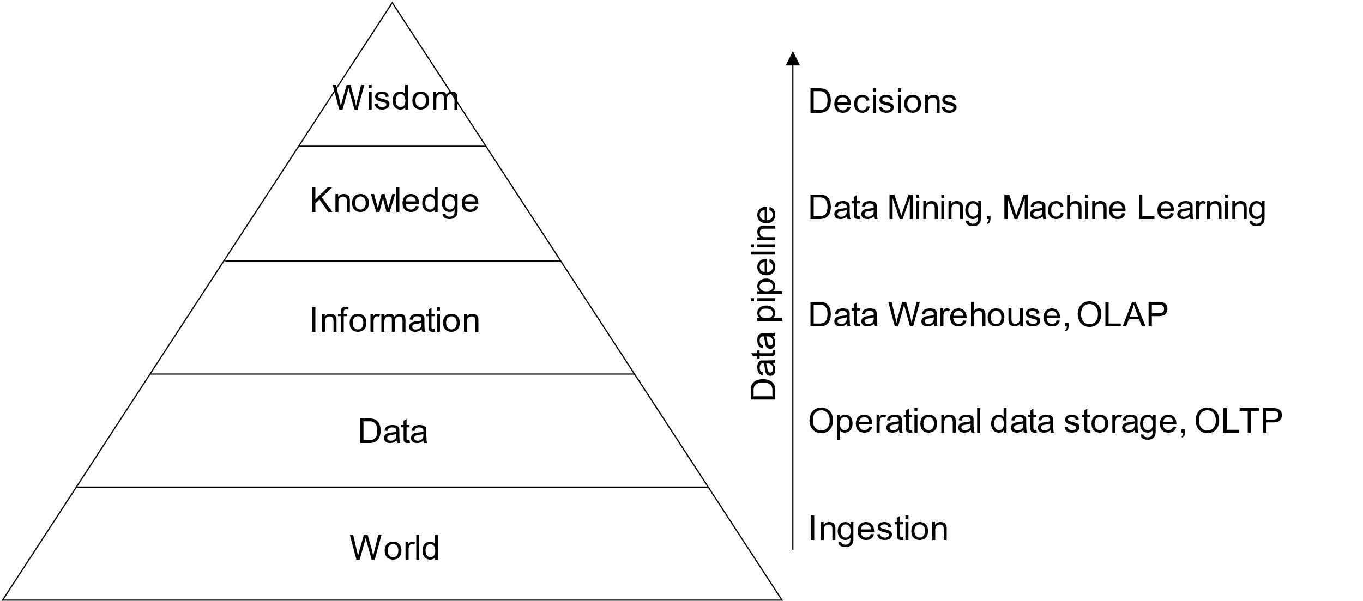
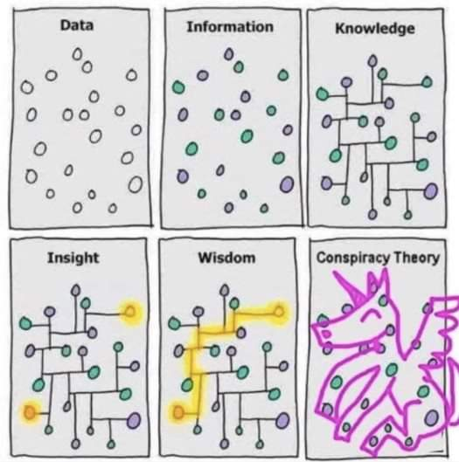
Modeling data pipelines
DIKW hierarchy
Layers representing structural relationships between data, information, knowledge, and wisdom
Ackoff, Russell L. "From data to wisdom." Journal of applied systems analysis 16.1 (1989): 3-9.

Slide 17
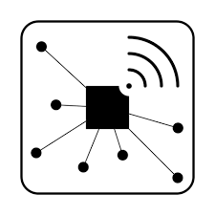

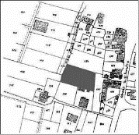
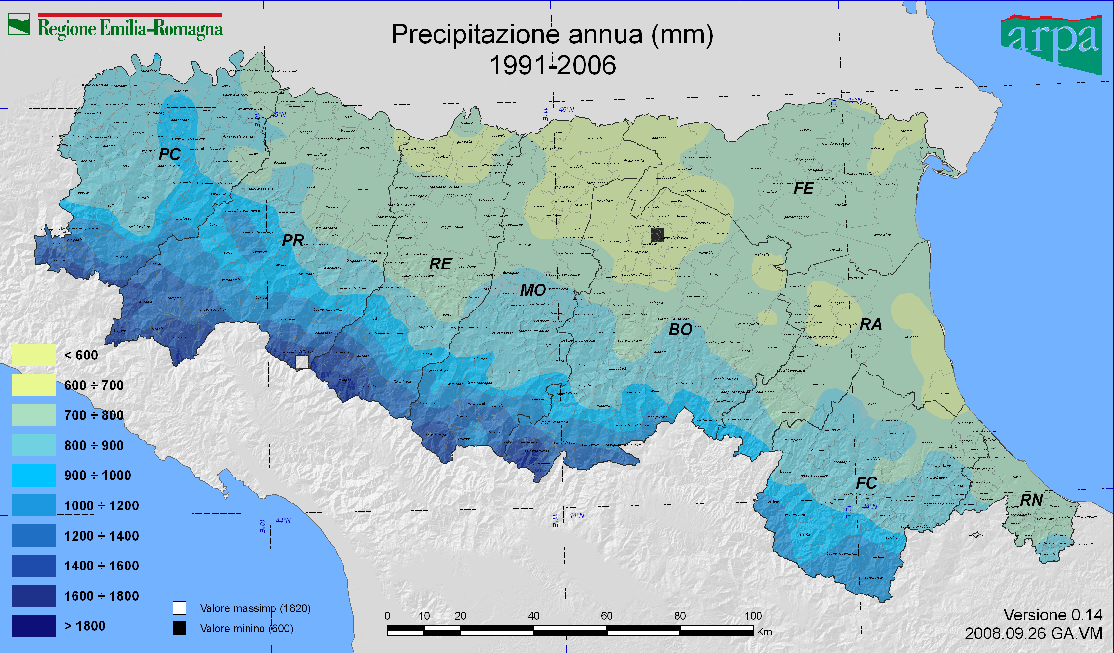
Data pipeline
Spatial Cube (PostGIS)
SOLAP Interface
Strategic Level
ETL
Web Interface
Loading process
ODS (Hbase + PostGIS)
Mobile Interface
Tactical Level
Integration processes
API
Web Interface
Loading processes
Notebook Interface
Raw level
Enrichment processes
Data Lake (Hadoop)
Web Interface
Acquisition processes
External sources
On-the-field sensors
Satellite images
Rural Land
register
Crop
register
Administrative
borders
Meteo
Ackoff, Russell L. "From data to wisdom." Journal of applied systems analysis 16.1 (1989): 3-9.

Slide 18
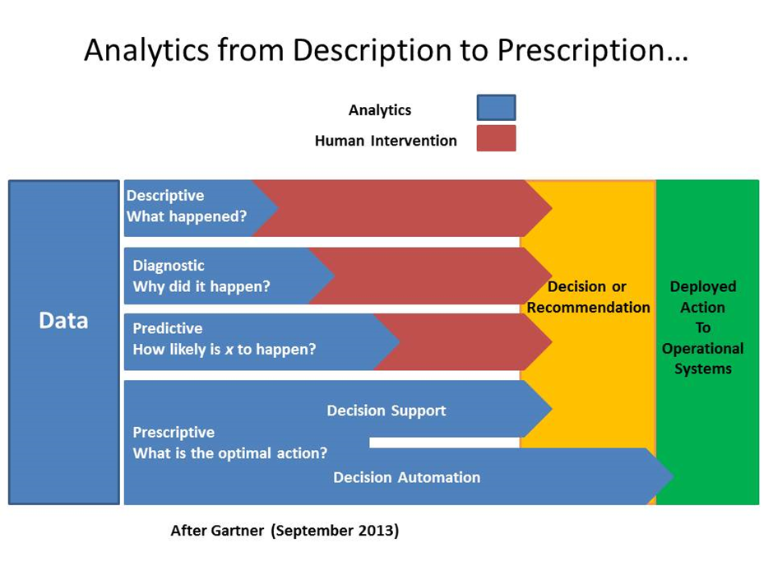
Modeling data pipelines

Slide 19
A tentative (service) organization
Orchestration
Fast storage
Ingestion
Real-time processing and analytics
Data consumers
Streaming data
Operational metadata
Data warehouse
Data consumers
Batch
data
Batch processing and analytics
Slow storage (data lake)
Data consumers
ETL tools overlay
Ingestion + Processing + Serving

Slide 20
Data platform in the agritech domain
The synergy of internet of things (IoT) and precision farming is producing valuable applications in the AgriTech domain [1]
AgriTech: use of technology for farming to improve efficiency and profitability
Some of our recent projects
Smart watering management to produce Kiwifruit with higher quality while saving water [2]
Sustainable weed management in with laser-based autonomous tools [4]
Agro.Big.Data.Science [5]
[1] Vitali, Giuliano, et al. "Crop management with the iot: An interdisciplinary survey." Agronomy 11.1 (2021): 181. [2] Francia, Matteo, et al. "Multi-sensor profiling for precision soil-moisture monitoring." Computers and Electronics in Agriculture 197 (2022): 106924. [3] Francia, Matteo, et al. "Making data platforms smarter with MOSES." Future Generation Computer Systems 125 (2021): 299-313. [4] https://cordis.europa.eu/project/id/101000256 [5] http://agrobigdatascience.it

Slide 21
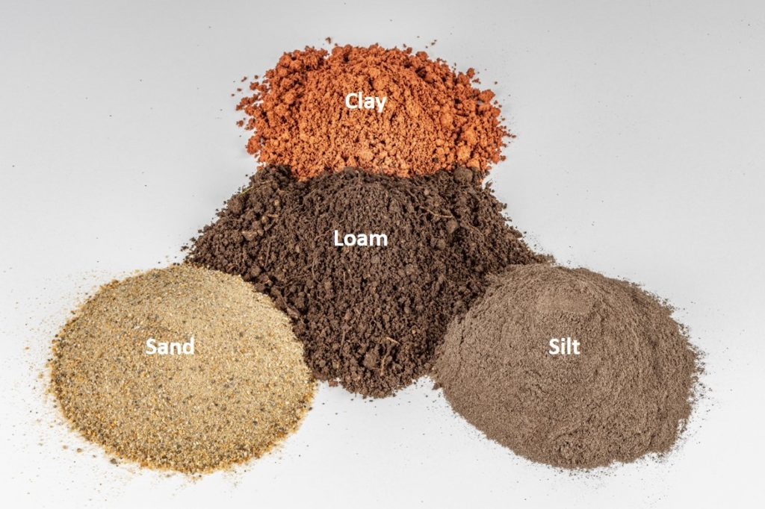
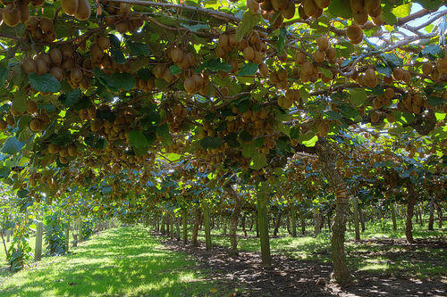
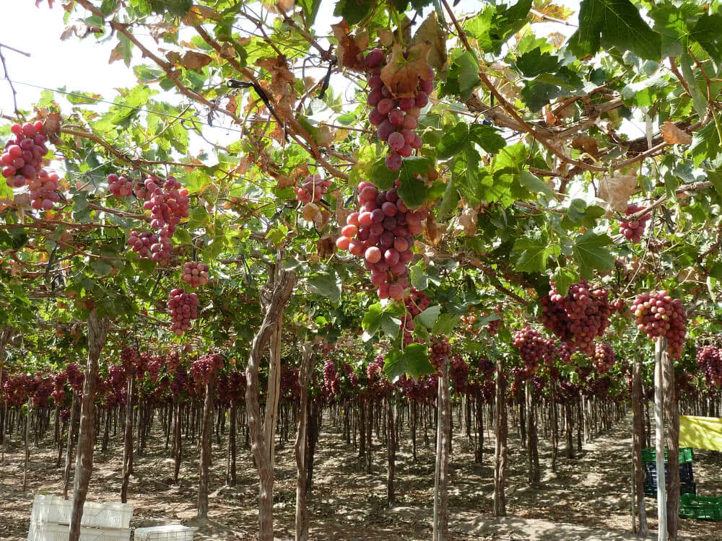
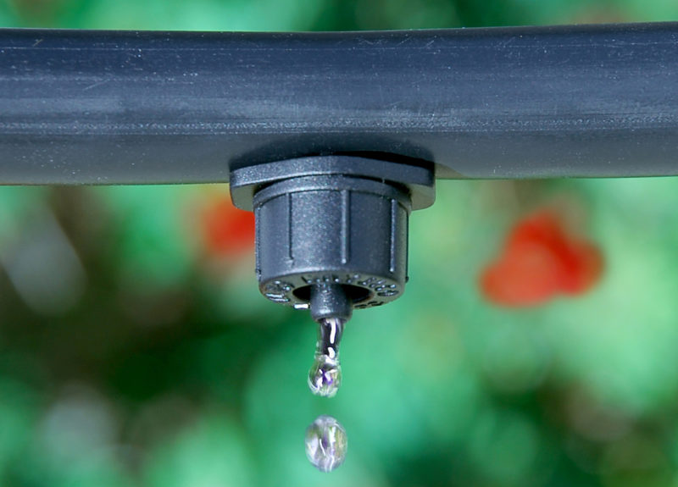
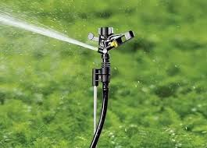
Soil moisture monitoring as a case study
Optimizing soil moisture is crucial for watering and crop performance [1]
GOAL: saving water while improving fruit quality (i.e., provide a recommendation of the amount necessary water)
Soils have different water retention
Watering systems have different behaviors (e.g., drippers and sprinklers)
Plants have different water demand (e.g., Kiwi [2] vs Grapes)
Sensors produce different measurements with different precisions
[1] Turkeltaub et al., Real-time monitoring of nitrate transport in the deep vadose zone under a crop field–implications for groundwater protection, Hydrology and Earth System Sciences 20 (8) (2016) 3099–3108. [2] M. Judd, et al., Water use by sheltered kiwifruit under advective conditions, New Zealand journal of agricultural research 29 (1) (1986) 83–92.

Slide 22
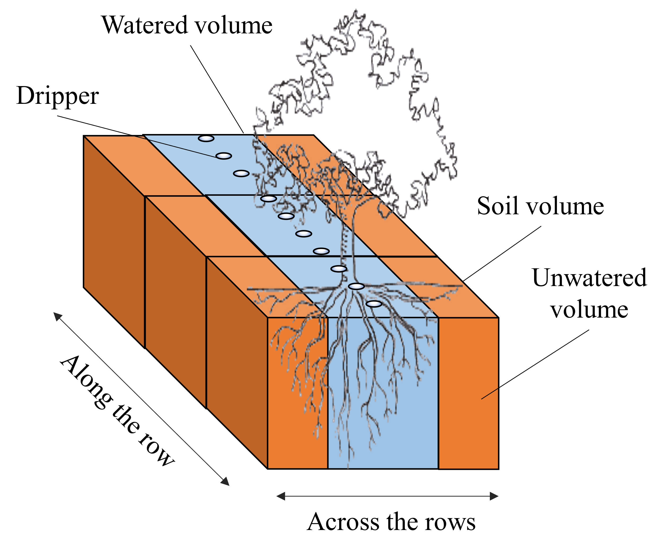
Reference scenario
We consider an orchard where
Kiwi plants are aligned along rows
Each row has many drippers (e.g., 1 every meter)
Drippers can water a limited soil volume
Francia, Matteo, et al. "Multi-sensor profiling for precision soil-moisture monitoring." Computers and Electronics in Agriculture 197 (2022): 106924.

Slide 23

Soil moisture monitoring as a case study
(Example) Scenarios of digital transformation in agriculture
Scenario #1
The farmer/technician controls the watering system based only on the experience
No digital data/KPIs/automation
Scenario #2
The control of the watering system is refined by observing sensor data
Sensor data is digitalized, no KPIs/automatic
Scenario #3
Sensor data feeds a decision support system that, knowing how to optimize KPIs, controls the watering system

Slide 24

Soil moisture monitoring as a case study
(Example) Scenarios of digital transformation in agriculture
Scenario #1
The farmer/technician controls the watering system based only on the experience
No digital data/KPIs/automation
Scenario #2
The control of the watering system is refined by observing sensor data
Sensor data is digitalized, no KPIs/automatic
Scenario #3
Sensor data feeds a decision support system that, knowing how to optimize KPIs, controls the watering system
Artificial intelligence (AI) is intelligence demonstrated by machines. AI research has been defined as the field of study of intelligent agents, which refers to any system that perceives its environment and takes actions that maximize its chance of achieving its goals.

Slide 25
Soil moisture monitoring as a case study
To achieve our goal, it necessary to understand of the soil behaves
Simulate [1, 2] the soil behavior according to physical models [3]
However a fine tuning is required, we need to know/parametrize everything
Soil (e.g., retention curve, hysteresis [3])
Plant (e.g., roots, LAI)
Weather conditions (temperature, humidity, wind, precipitations)
Watering system (e.g., capacity, distance between drippers)
Tuning can take months (of human interactions)!
Need to collect samples from the field… if some parameter is incorrect we need to trace back
Need to implement/code all these features into the simulator [1, 2]
Hyper-parameter tuning with machine learning can help, but it is not a silver bullet
[1] Šimunek, J., et al. "HYDRUS: Model use, calibration, and validation." Transactions of the ASABE 55.4 (2012): 1263-1274. [2] Bittelli, Marco, et al. Soil physics with Python: transport in the soil-plant-atmosphere system. OUP Oxford, 2015. [3] Van Genuchten, M. Th. "A closed‐form equation for predicting the hydraulic conductivity of unsaturated soils." Soil science society of America journal 44.5 (1980): 892-898. [4] Pham, Hung Q., Delwyn G. Fredlund, and S. Lee Barbour. "A study of hysteresis models for soil-water characteristic curves." Canadian Geotechnical Journal 42.6 (2005): 1548-1568.

Slide 26
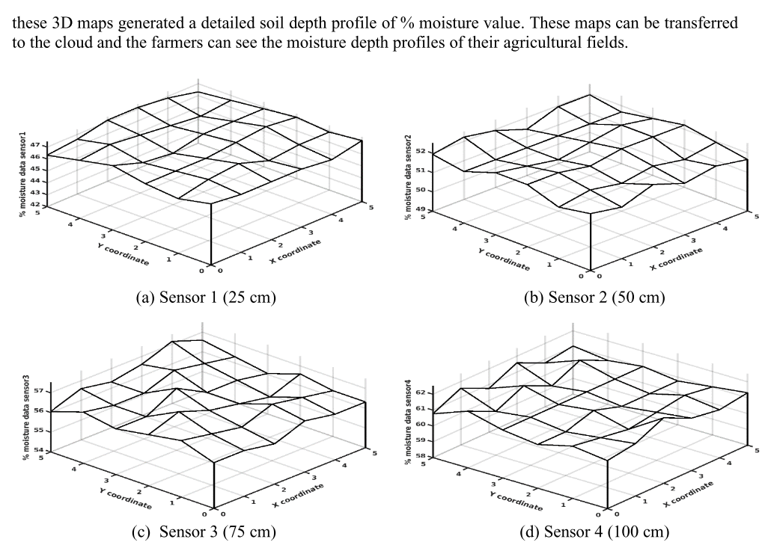
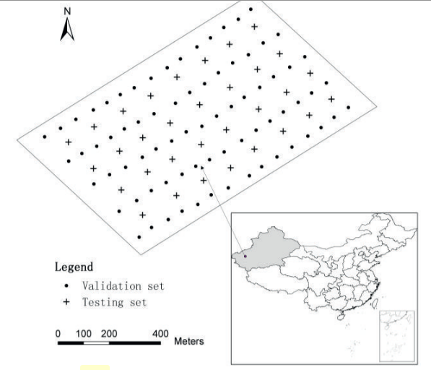
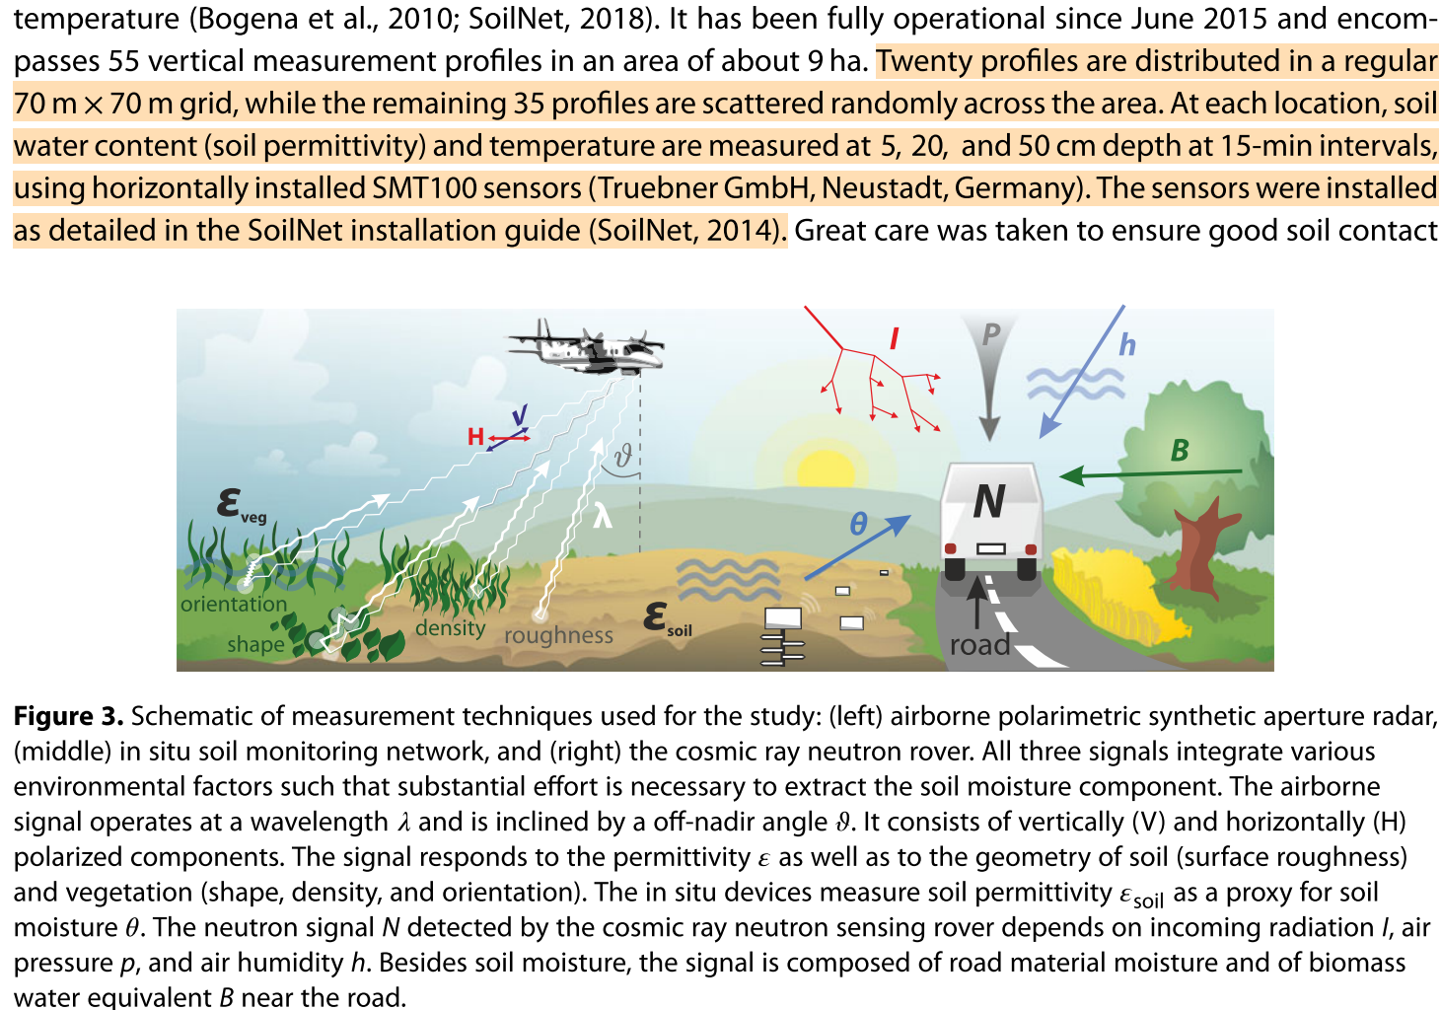
Soil moisture monitoring as a case study
But… we have sensors! [1] [2] [3]
These settings are too coarse to monitor soil moisture with precision, and they require many sensors
[1] Koyuncu, Hakan, et al. "Construction of 3D soil moisture maps in agricultural fields by using wireless sensor communication." Gazi University Journal of Science 34.1 (2021): 84-98. [2] Zheng, Zhong, et al. "Spatial estimation of soil moisture and salinity with neural kriging." International Conference on Computer and Computing Technologies in Agriculture. Springer, Boston, MA, 2008. [3] Fersch, Benjamin, et al. "Synergies for soil moisture retrieval across scales from airborne polarimetric SAR, cosmic ray neutron roving, and an in situ sensor network." Water Resources Research 54.11 (2018): 9364-9383.

Slide 27
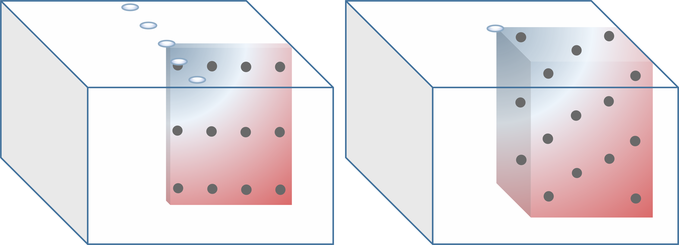
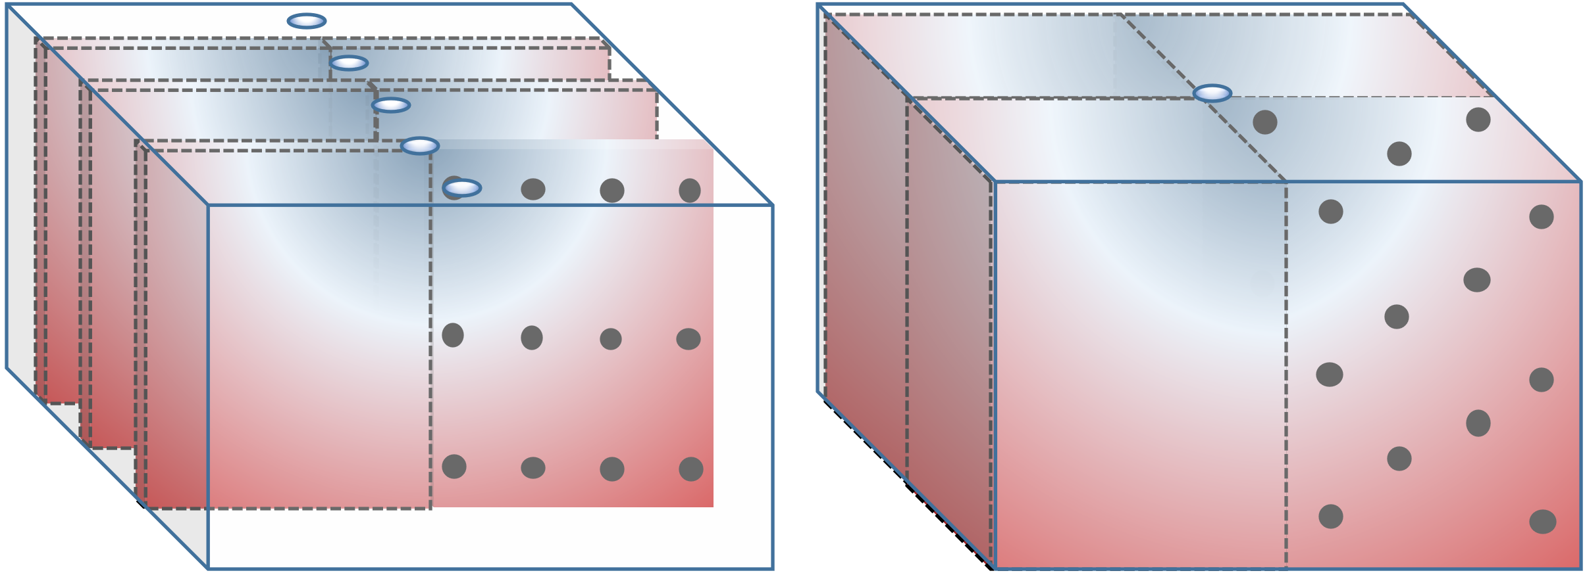
Sensor layouts and symmetry
If watered volume is symmetric along the row, a 2D sensor grid is sufficient to represent the soil volume
If moisture variations take place along the row too, a 3D grid of sensors is required
E.g., too sparse drippers
Francia, Matteo, et al. "Multi-sensor profiling for precision soil-moisture monitoring." Computers and Electronics in Agriculture 197 (2022): 106924.

Slide 28
Sensor layouts and symmetry
When the watered volume is symmetric along the row, a 2D grid of sensors (left) is sufficient to represent the entire soil volume
When relevant moisture variations take place along the row too, a 3D grid of sensors (right) is required
E.g., too sparse drippers
E.g., non-homogeneous root suction
Francia, Matteo, et al. "Multi-sensor profiling for precision soil-moisture monitoring." Computers and Electronics in Agriculture 197 (2022): 106924.

Slide 29

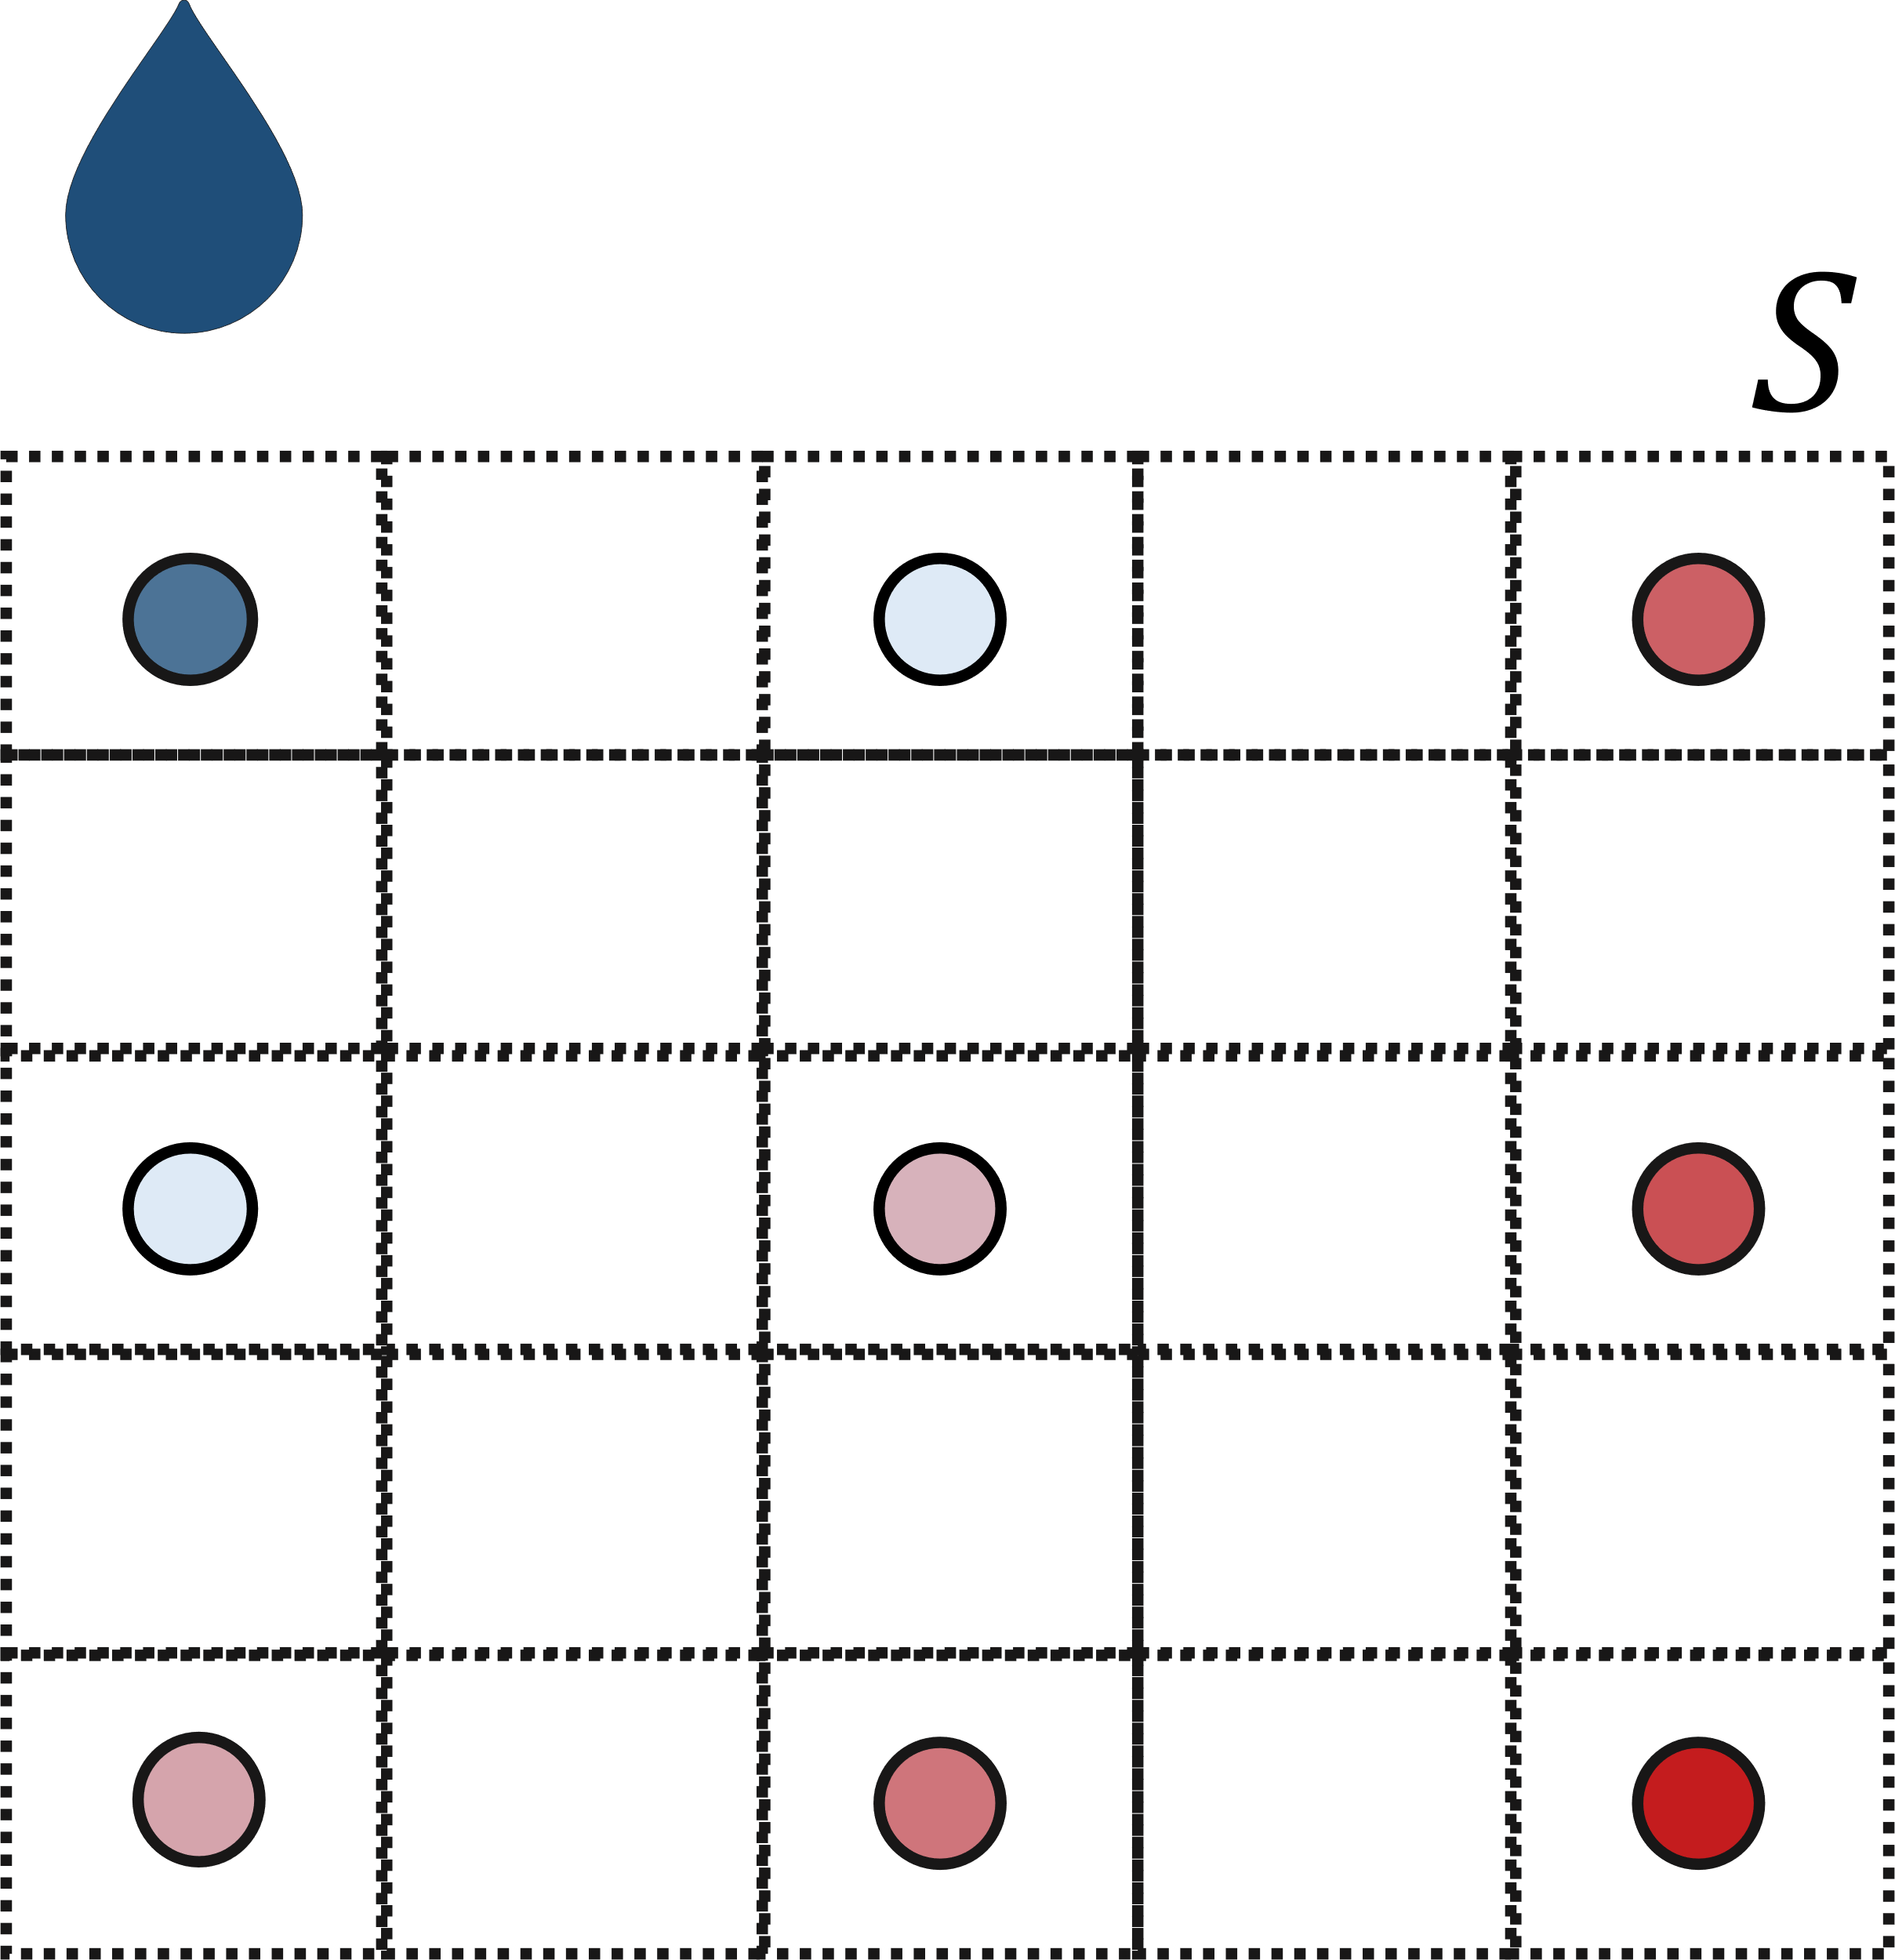
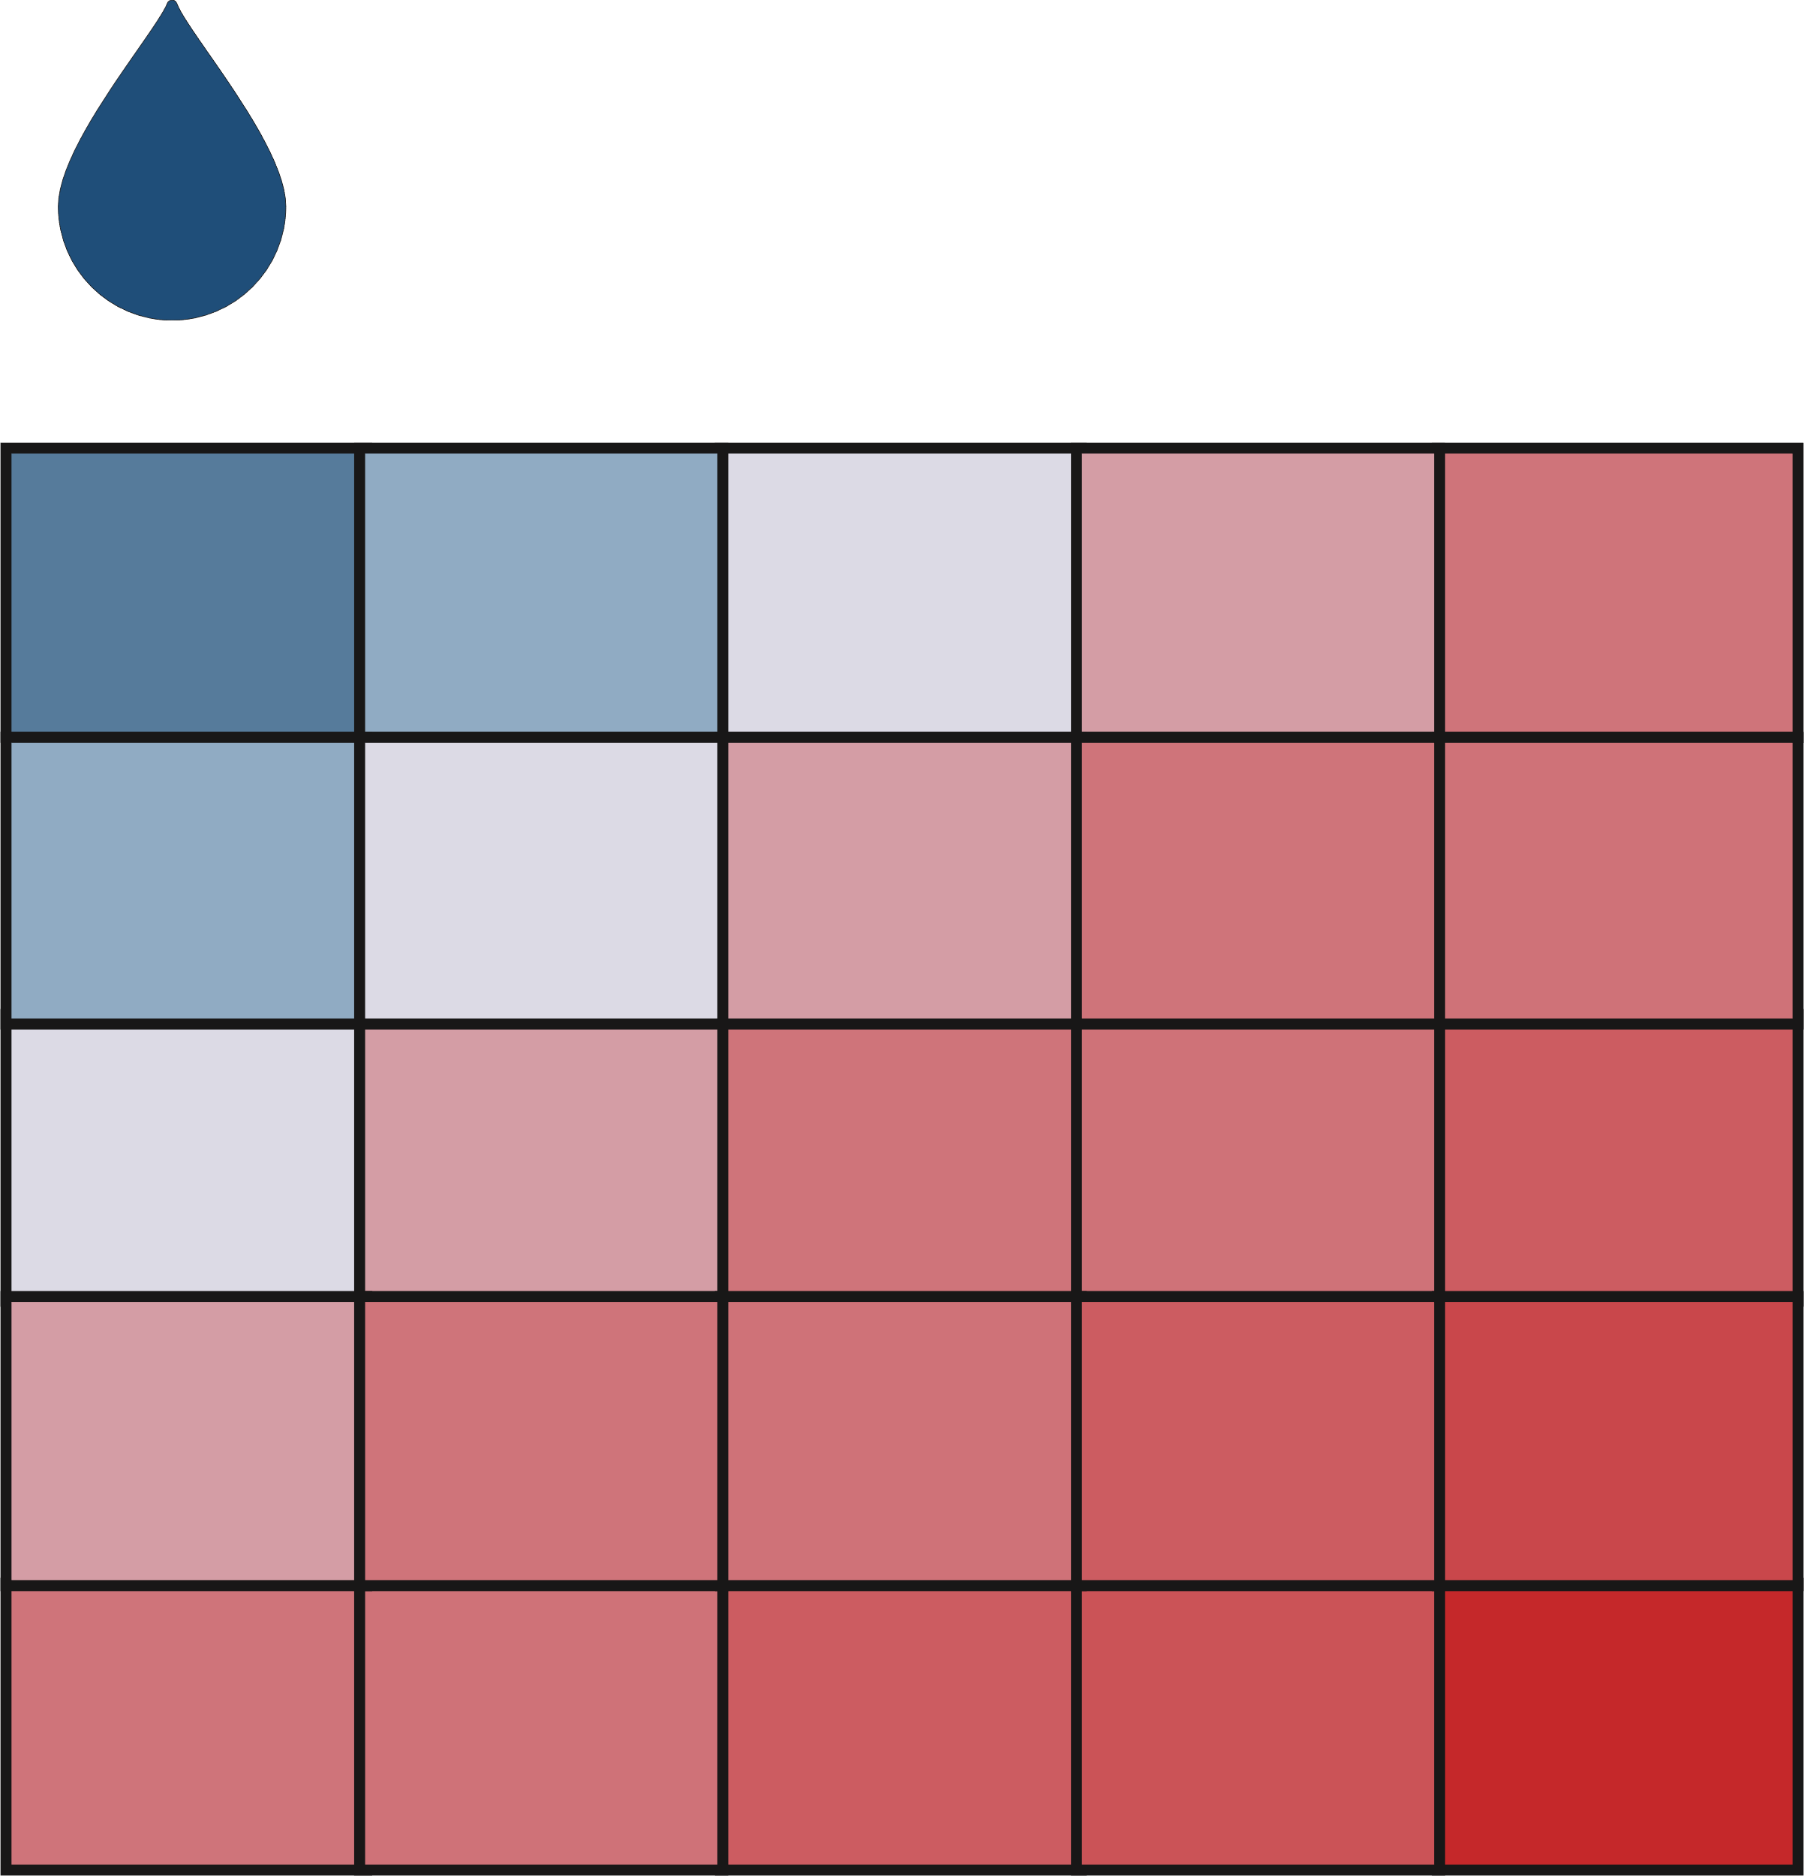
From sensors to soil profiles
(a) Soil moisture is a continuum in the soil
(b) Sensors return a discretized representation of soil moisture
Depending on the number of sensors and on their layout the monitoring accuracy changes
(c) Goal: produce fine-grained soil profiles out of coarse-grained layouts
Francia, Matteo, et al. "Multi-sensor profiling for precision soil-moisture monitoring." Computers and Electronics in Agriculture 197 (2022): 106924.

Slide 30
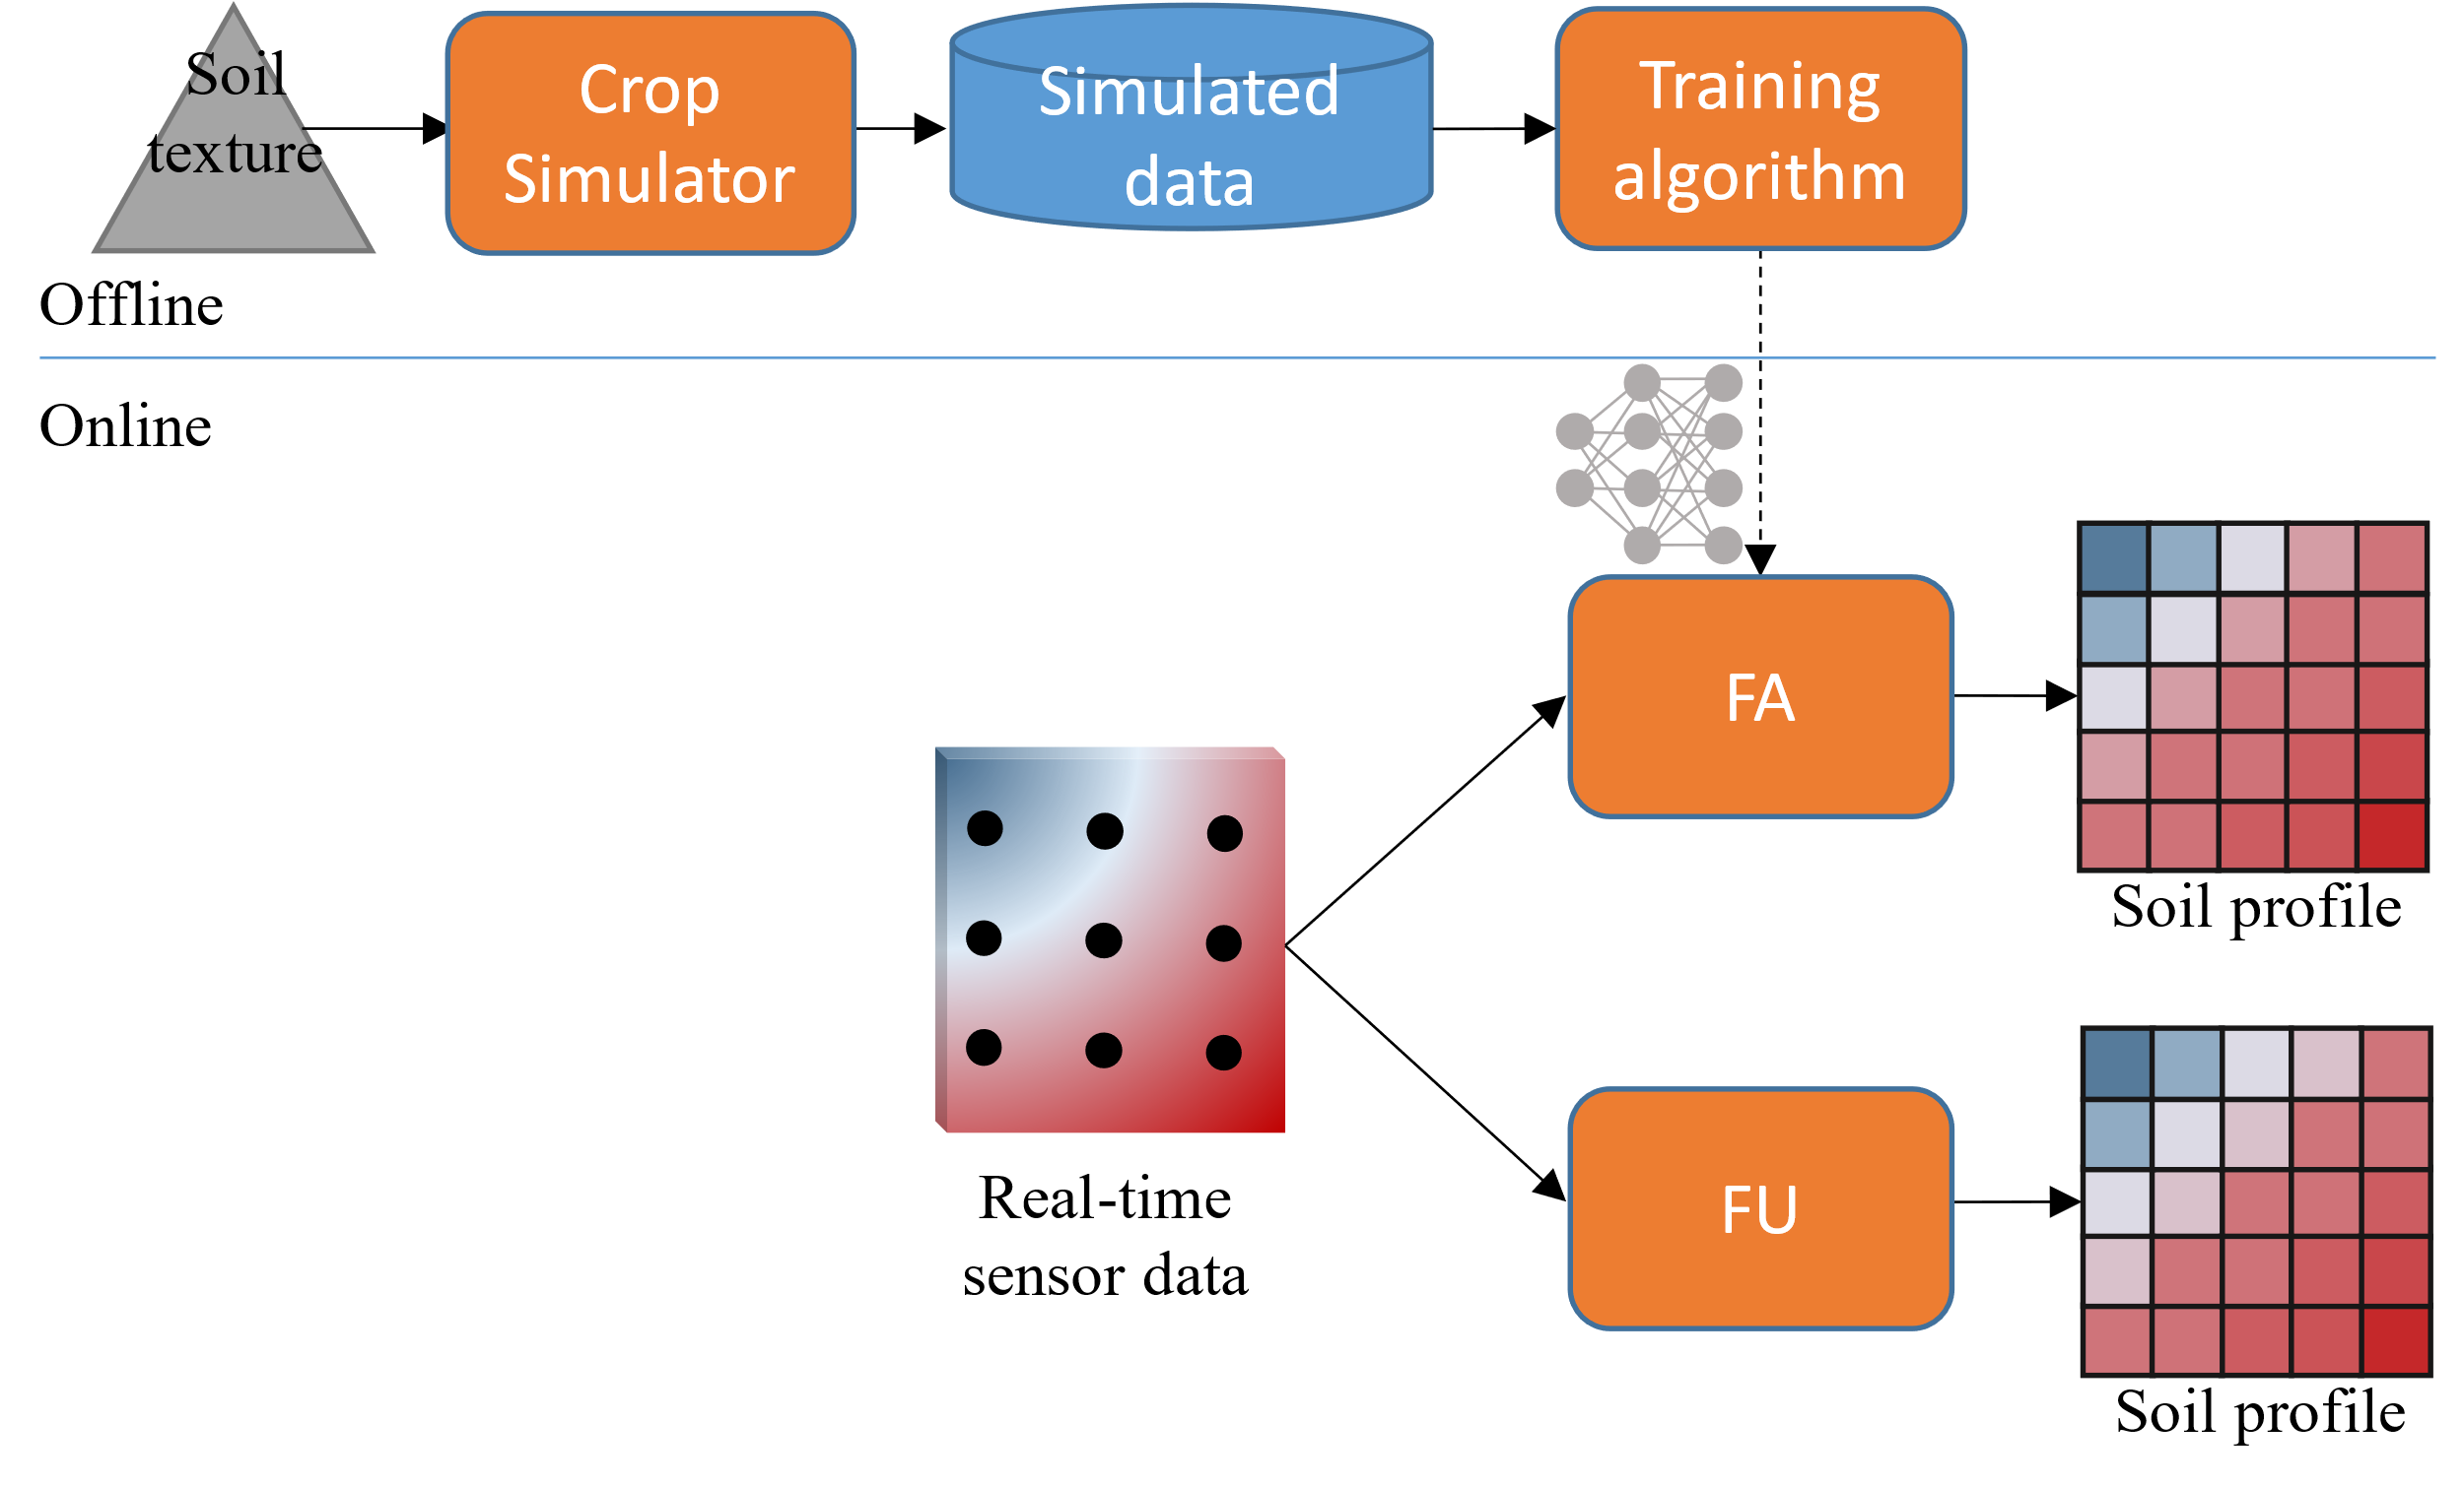
Overview
Francia, Matteo, et al. "Multi-sensor profiling for precision soil-moisture monitoring." Computers and Electronics in Agriculture 197 (2022): 106924.

Slide 31
Ingestion
Setup
We install a 2D/3D grid of sensors
For instance, in the 2D setting
4 columns of sensors are located across the row (e.g., 0/30/60/90cm)
The column (0, *) is under the dripper
Each columns has 3 sensors located at 3 depths (e.g., 20/40/60cm)
Francia, Matteo, et al. "Multi-sensor profiling for precision soil-moisture monitoring." Computers and Electronics in Agriculture 197 (2022): 106924.

Slide 32
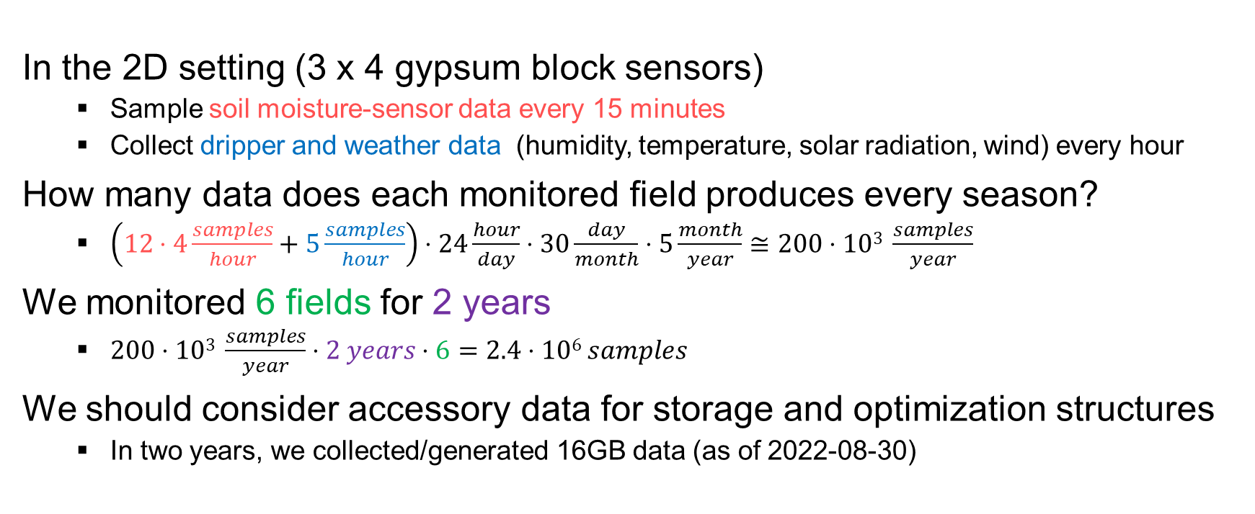
Ingestion
In the 2D setting (3 x 4 gypsum block sensors)
Sample soil moisture-sensor data every 15 minutes
Collect dripper and weather data (humidity, temperature, solar radiation, wind) every hour
How many data does each monitored field produces every season?
$\left(12⋅4\frac{samples}{hour}+5\frac{samples}{hour}\right)⋅24\frac{hour}{day}⋅30\frac{day}{month}⋅5\frac{month}{year}≅200⋅103 \frac{samples}{year}$
We monitored 6 fields for 2 years
$200⋅103 \frac{samples}{year}⋅2 years⋅6=2.4⋅106 samples$
We should consider accessory data for storage and optimization structures
In two years, we collected/generated 16GB data (as of 2022-08-30)
Francia, Matteo, et al. "Multi-sensor profiling for precision soil-moisture monitoring." Computers and Electronics in Agriculture 197 (2022): 106924.

Slide 33
Processing
Batch Processing
Feature unaware (FU)
Plug-and-play
Create a linear interpolation of the real-time sensor data
Feature aware (FA)
Require time for data collection and training/testing
Create an interpolation of the real-time sensor data through machine learning
Streaming Processing
Francia, Matteo, et al. "Multi-sensor profiling for precision soil-moisture monitoring." Computers and Electronics in Agriculture 197 (2022): 106924.

Slide 34
Processing
Feature unaware
Create a linear interpolation of the real-time sensor data
y
s1
s2
s3
s4
p
s5
s6
s7
s8
s9
s10
s11
s12
x
Francia, Matteo, et al. "Multi-sensor profiling for precision soil-moisture monitoring." Computers and Electronics in Agriculture 197 (2022): 106924.

Slide 35
Processing
Feature unaware
Create a linear interpolation of the real-time sensor data
y
y
s1
s2
s3
s4
ys12
s1
r12
s2
p
s5
s6
s7
s8
yp
p
s9
s10
s11
s12
s5
r56
s6
ys56
x
xs15
xp
xs26
x
Francia, Matteo, et al. "Multi-sensor profiling for precision soil-moisture monitoring." Computers and Electronics in Agriculture 197 (2022): 106924.

Slide 36
Processing
Feature aware
Create an interpolation of the real-time sensor data through machine learning
Offline pipeline
Given the soil texture as input
Simulate different patterns of SM to produce a dataset of simulated SM
Train a machine learning model on such data
Deploy the model to estimate the soil profile
Francia, Matteo, et al. "Multi-sensor profiling for precision soil-moisture monitoring." Computers and Electronics in Agriculture 197 (2022): 106924.

Slide 37
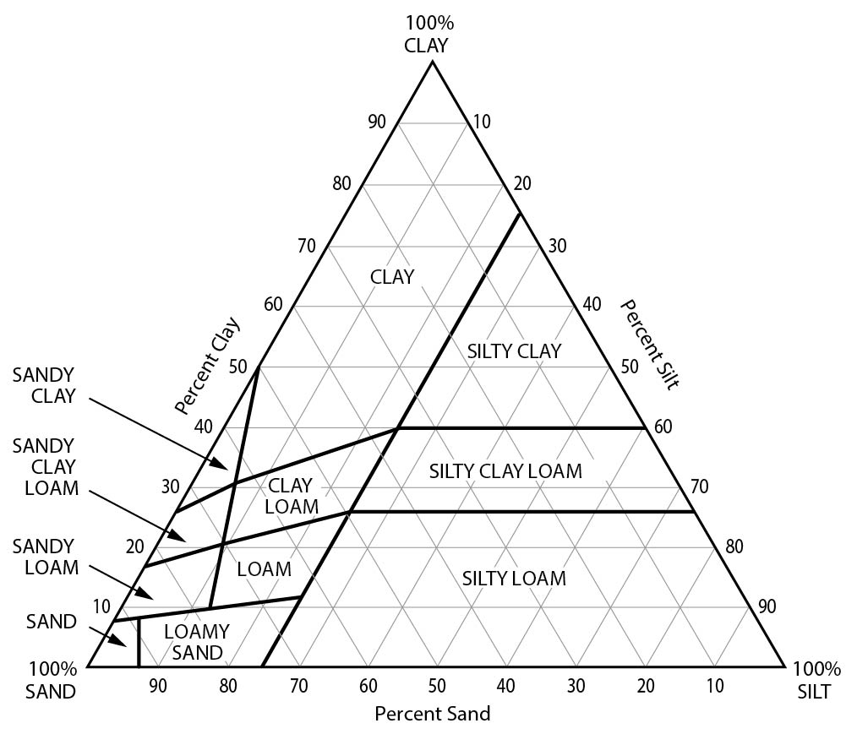
Notes:
Clay = argilla
Silt = limo

Slide 38
Processing
?
Input
Output
S
P
s¹.v
p¹.v
s^{|S|}.v
p^{|P|}.v
s^{|S|}.v
p^{|P|}.v
s^{|S|}.v
p^{|P|}.v
s^{|S|}.v
p^{|P|}.v
s^{|S|}.v
p^{|P|}.v
How do you classify this task?
Which issues do you foresee?
Francia, Matteo, et al. "Multi-sensor profiling for precision soil-moisture monitoring." Computers and Electronics in Agriculture 197 (2022): 106924.

Slide 39
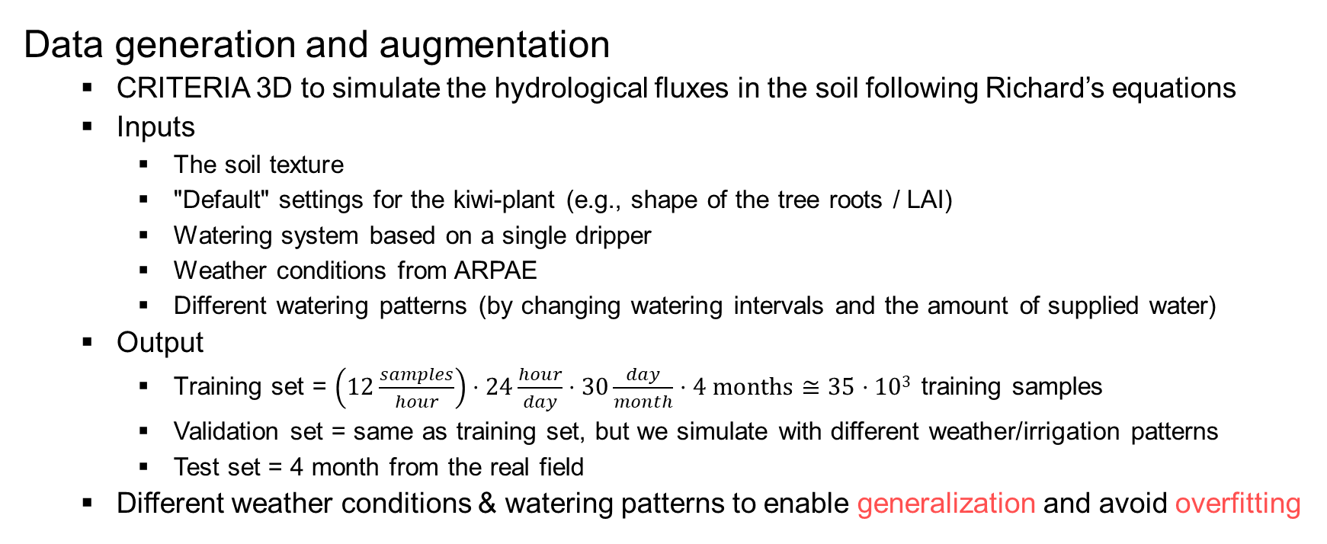
Processing
Data generation and augmentation
CRITERIA 3D to simulate the hydrological fluxes in the soil following Richard’s equations
Inputs
The soil texture
"Default" settings for the kiwi-plant (e.g., shape of the tree roots / LAI)
Watering system based on a single dripper
Weather conditions from ARPAE
Different watering patterns (by changing watering intervals and the amount of supplied water)
Output
Training set = $\left(12\frac{samples}{hour}\right)⋅24\frac{hour}{day}⋅30\frac{day}{month}⋅4 months≅35⋅103$ training samples
Validation set = same as training set, but we simulate with different weather/irrigation patterns
Test set = 4 month from the real field
Different weather conditions & watering patterns to enable generalization and avoid overfitting
ARPAE: Agenzia regionale per la prevenzione, l'ambiente e l'energia dell'Emilia-Romagna

Slide 40
Processing
A
B
C
Given many As as inputs
Learn their relationships to many Bs
Test the error against actual sensor data Cs
Synthetic data from the simulator
Real data from the field

Slide 41
Processing
This is a (multi-output) regression problem
The task is to learn the function mapping the input to the continuous output
We tried several machine learning models
SVR, Random Forest Regression, Linear Regression, and ANN
(A simple) ANN is the best performing model
The hyper parameters (structure/learning rates) are set through a hyper-parameter tuning process
HyperOpt: state-of-the-art optimization technique to explore the huge search space of hyper-parameters
https://scikit-learn.org/stable/modules/generated/sklearn.svm.SVR.html https://scikit-learn.org/stable/modules/generated/sklearn.ensemble.RandomForestRegressor.html https://scikit-learn.org/stable/modules/generated/sklearn.linear_model.LinearRegression.html https://keras.io

Slide 42
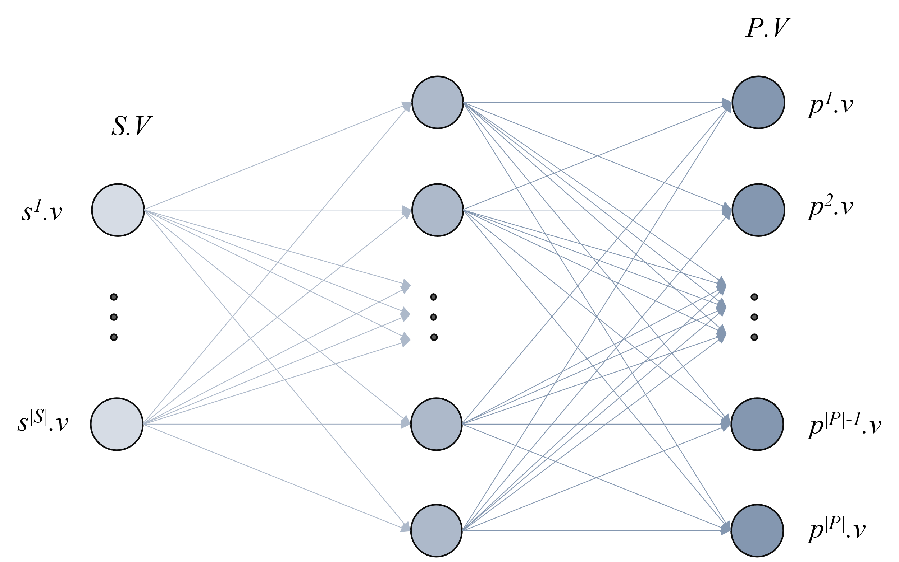
Processing
S
P
s¹.v
p¹.v
s^{|S|}.v
p^{|P|}.v
Francia, Matteo, et al. "Multi-sensor profiling for precision soil-moisture monitoring." Computers and Electronics in Agriculture 197 (2022): 106924. https://keras.io/api/callbacks/reduce_lr_on_plateau

Slide 43
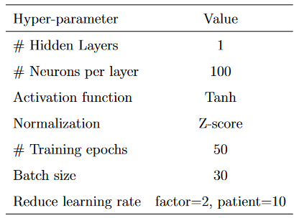
Processing
S
P
s¹.v
p¹.v
s^{|S|}.v
p^{|P|}.v
Francia, Matteo, et al. "Multi-sensor profiling for precision soil-moisture monitoring." Computers and Electronics in Agriculture 197 (2022): 106924. https://keras.io/api/callbacks/reduce_lr_on_plateau

Slide 44
Processing
Feature unaware
Feature aware
Francia, Matteo, et al. "Multi-sensor profiling for precision soil-moisture monitoring." Computers and Electronics in Agriculture 197 (2022): 106924.

Slide 45
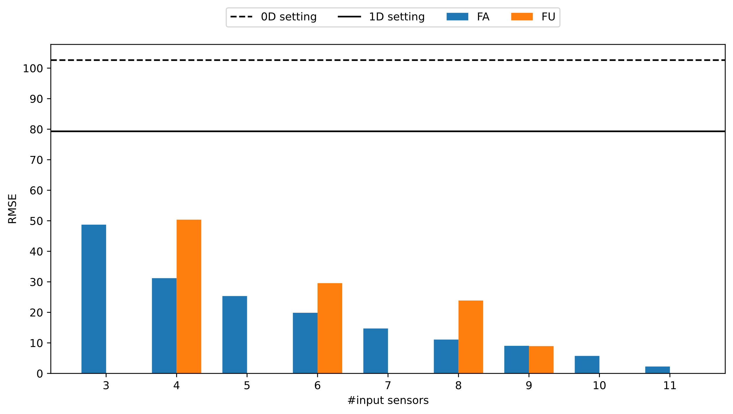
Processing: empirical evaluation

Slide 46
Processing: empirical evaluation
If I got 4 sensors, what layout should I choose?

Slide 47
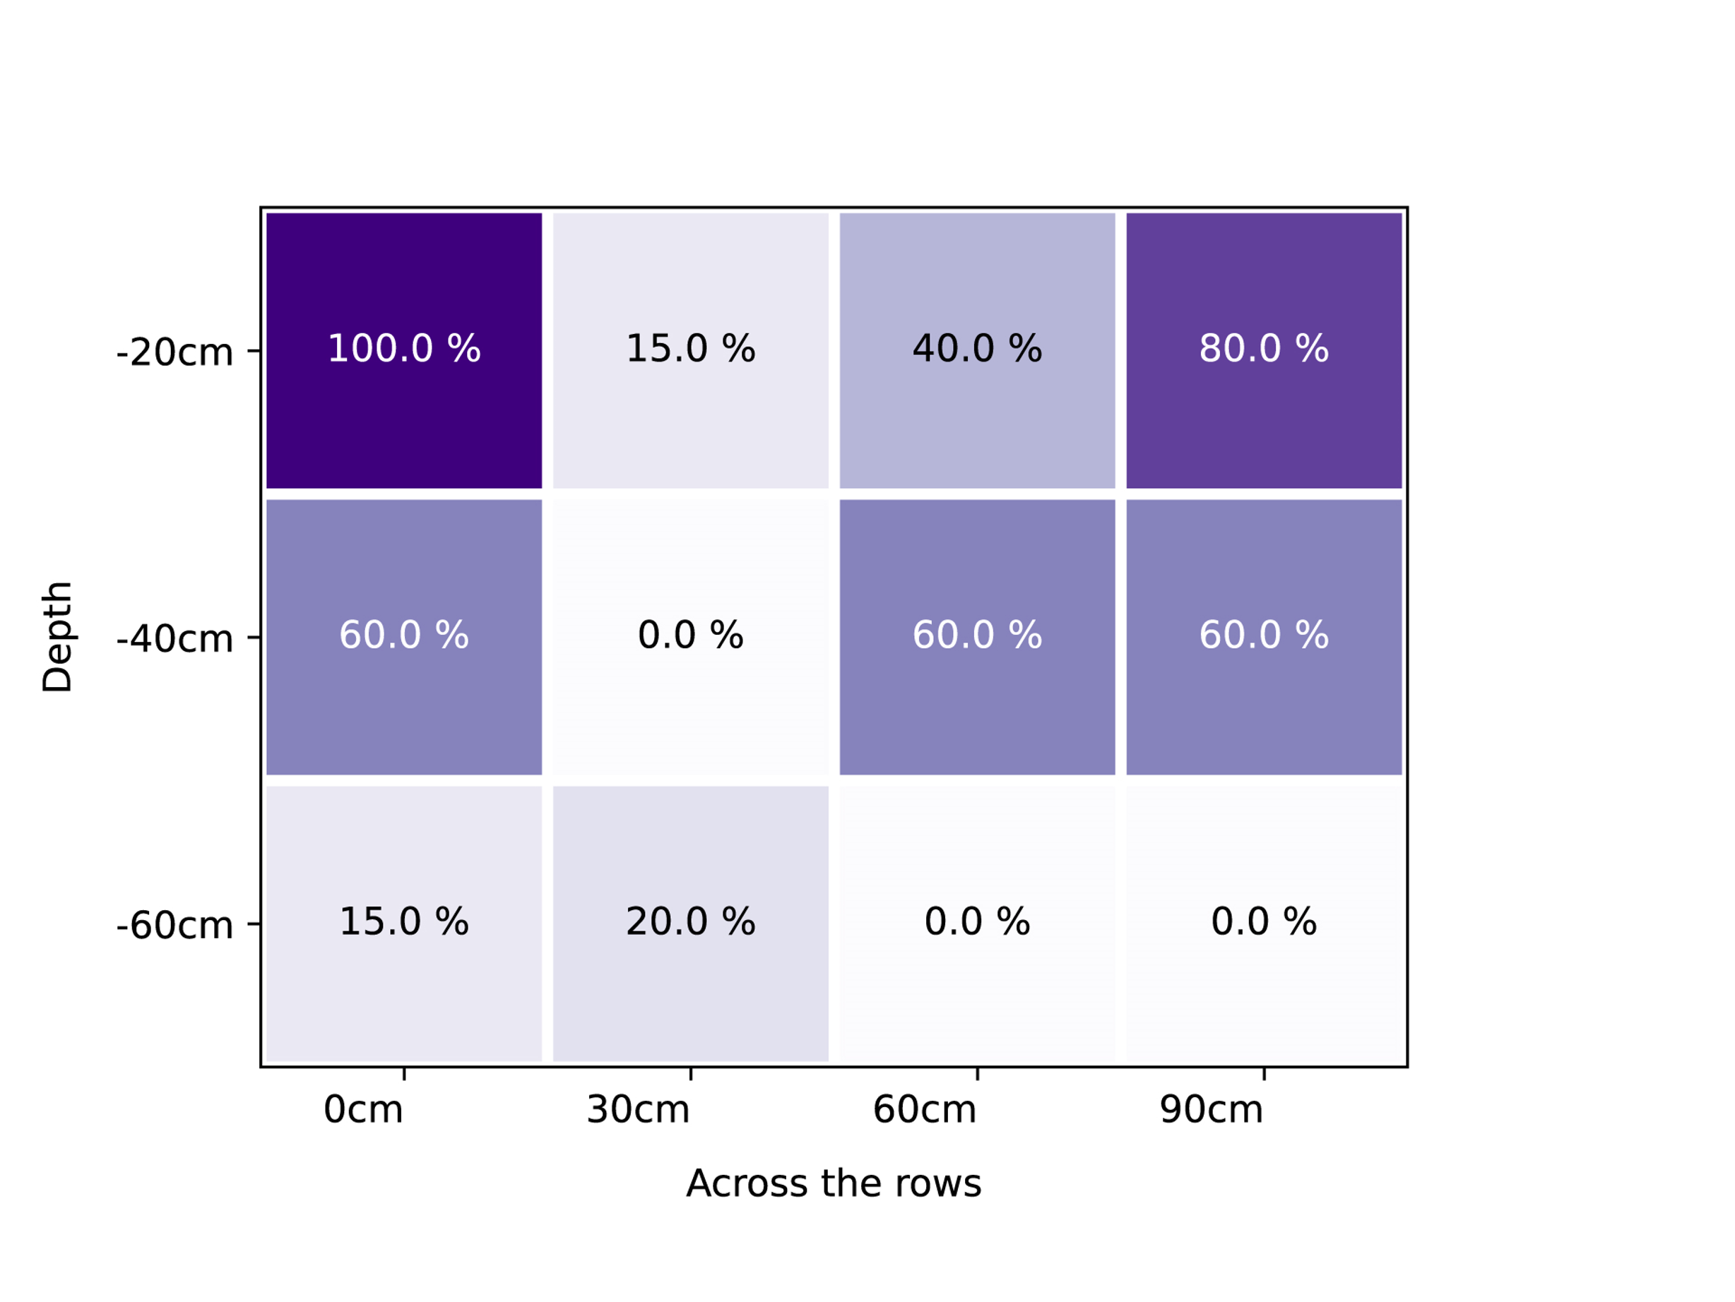
Processing: empirical evaluation
If I got 4 sensors, what layout should I choose?

Slide 48
Processing: empirical evaluation
If I got 4 sensors, what layout should I choose?

Slide 49
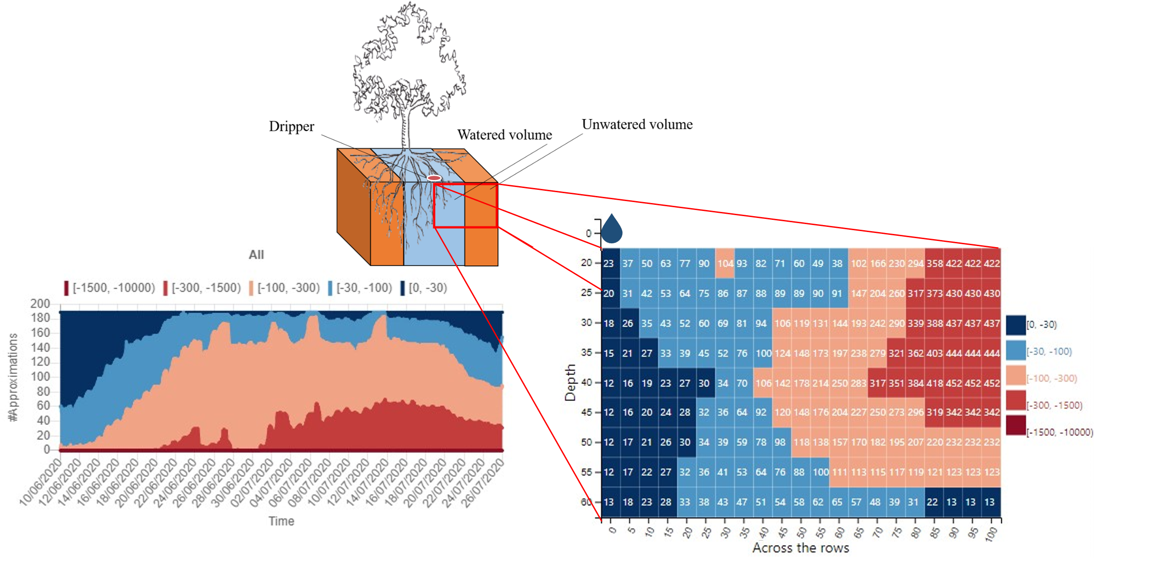
Serving
Francia, Matteo, et al. "Multi-sensor profiling for precision soil-moisture monitoring." Computers and Electronics in Agriculture 197 (2022): 106924.

Slide 50
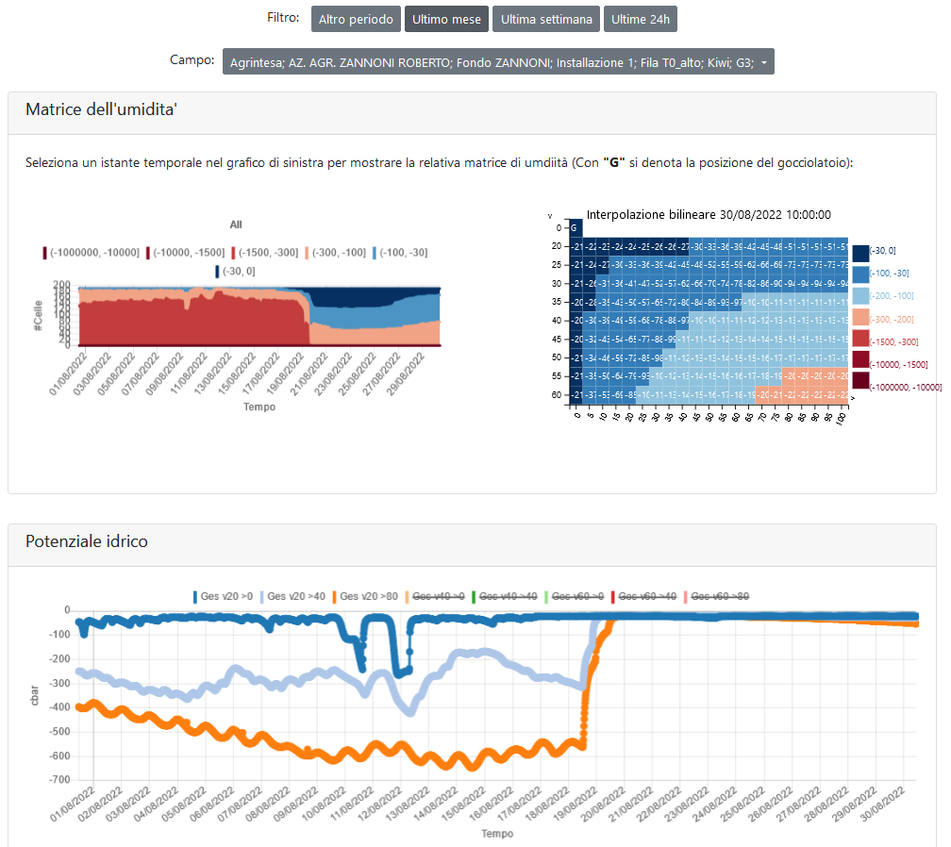
Serving
Notes:
https://big.csr.unibo.it/projects/watering/

Slide 51
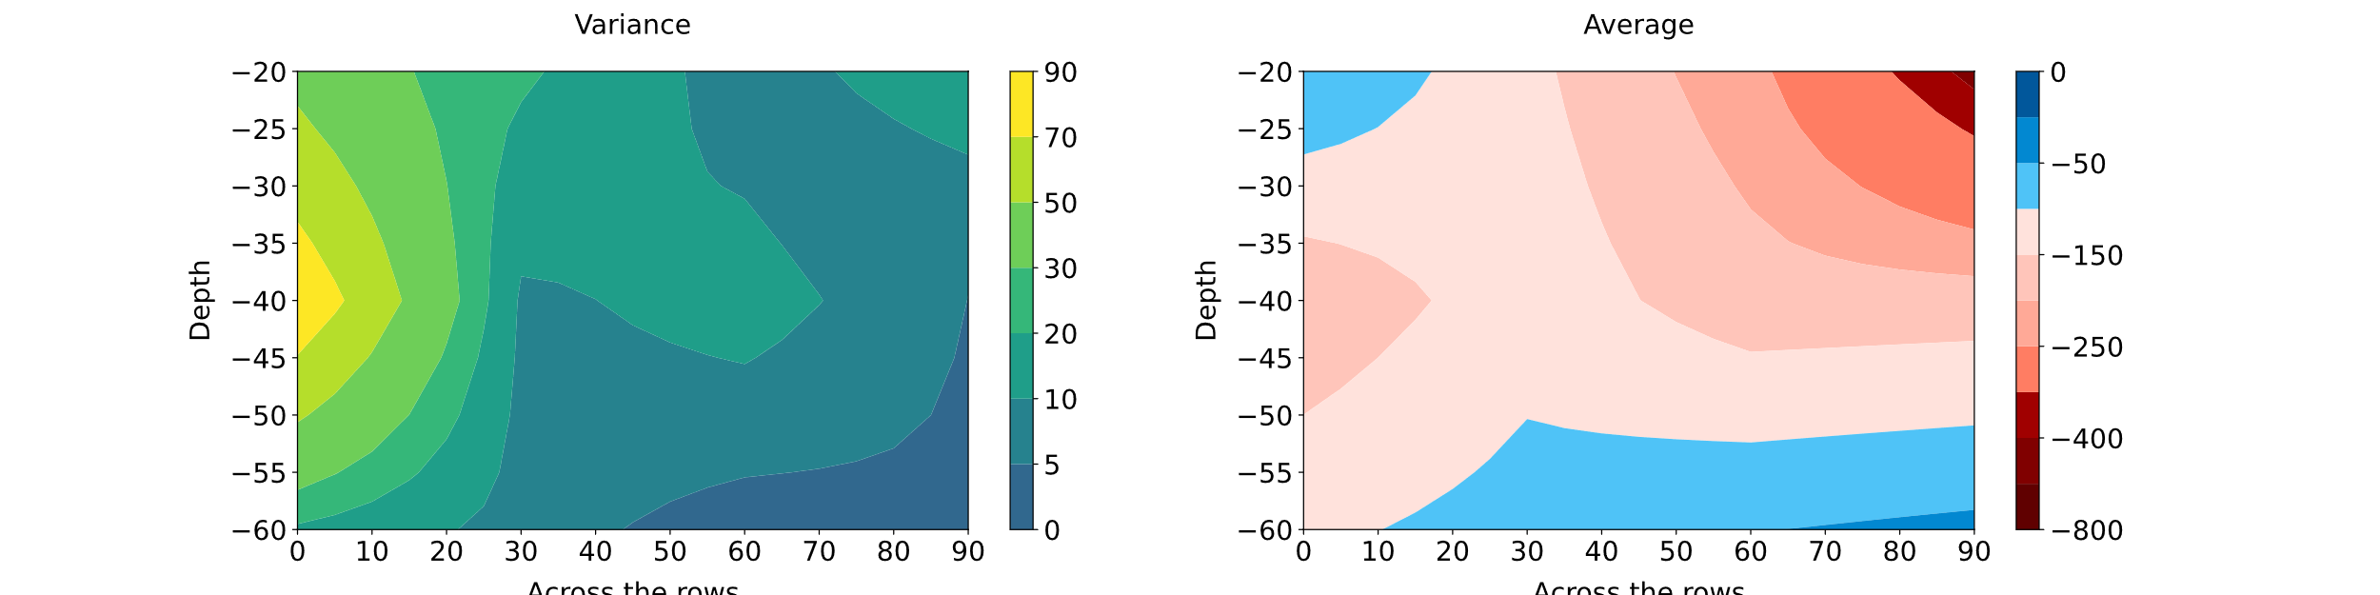
Descriptive Analytics
Starting from the profile, we derive meaningful visualizations/analysis
SM variance (left; lighter areas are those where SM varies the most) and average (right)
The charts support both agricultural technicians and farmers
What is the watered volume?
This region is typically characterized by watering and high suction by the roots
Over-watering: high values in the average chart and low values in the variance chart
Where is the root suction higher?
A high root suction quickly reduces the moisture in the soil and results in high soil moisture variance
How soil moisture dynamics impact on the watered volume?
If, after increasing the water supplied, the profile does not change then the soil disperses water

Slide 52
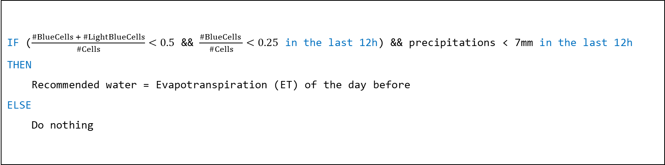
Prescriptive Analytics
Watering recommendation
IF ($\frac{\#BlueCells + \#LightBlueCells}{\#Cells}<0.5$ && $\frac{\#BlueCells }{\#Cells}<0.25$ in the last 12h) && precipitations < 7mm in the last 12h
THEN
Recommended water = Evapotranspiration (ET) of the day before
ELSE
Do nothing
M. Quartieri, M. Toselli, E. Baldi, G. Polidori, M. Germani, M. Noferini, E. Xylogiannis, Effect of the method and volume of irrigation on yield and fruit quality of yellow fleshed kiwifruit in northern Italy, in: X International Symposium on Kiwifruit 1332, 2021, pp. 211–218.

Slide 53
Prescriptive Analytics
Notes:
https://big.csr.unibo.it/projects/watering/

Slide 54
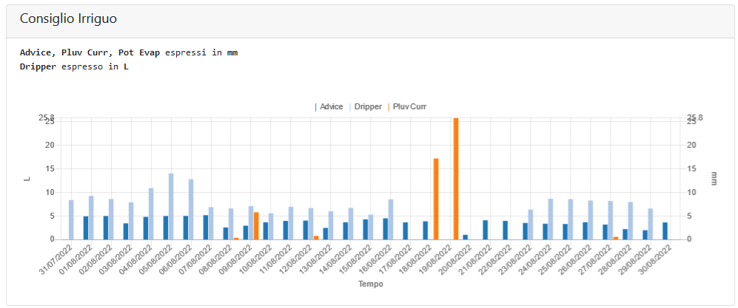
Prescriptive Analytics
Notes:
https://big.csr.unibo.it/projects/watering/

Slide 55
Prescriptive Analytics
Two irrigation setups during the 2021 campaign (i.e., May/October) within the same orchard
Managed Row: irrigation is automatically controlled using a 2D installation of 12 sensor
Control Row: irrigation is manually controlled by the farmer
Results
Water management
MR saved 44% of water during the whole campaign
Maximum saving in June and September: for the farmer is harder to estimate the SM level and water requirement
Fruit quality
Productivity of vines was unaffected by the irrigation and ranged from 32 to 39 kg/vine (35-44 t/ha)
Fruits from CR appeared greener (hue angle of 105) than fruits from MR (hue angle of 102)
Fruits from CR had lower soluble solid concentration at harvest (12.7 brix) than fruits from MR (15.3 brix)
The gap has been maintained after 2 months of storage (and 1 day of shelf life)
The soluble solid concentration was 17.4 brix for the MR vs 16.1 brix for the CR
M. Quartieri, M. Toselli, E. Baldi, G. Polidori, M. Germani, M. Noferini, E. Xylogiannis, Effect of the method and volume of irrigation on yield and fruit quality of yellow fleshed kiwifruit in northern italy, in: X International Symposium on Kiwifruit 1332, 2021, pp. 211–218.

Slide 56
Future direction: soil moisture profiling
Continual learning to overcome the limitations of the simulation
Adapting the model after its deployment
Use the data that is coming into the production environment and retrain the model based
Fit to unforeseen field conditions
Improving the recommendation
Sometimes the soil does not behave as expected
Homogeneous water recommendation; however, we need to handle:
The "water needs" of the plant
The phenological growth stages
Field conditions
Latitude/longitude
Availability of water

Slide 57
Future direction: forecasting
While profiling looks at the current state of soil moisture, how will soil moisture change --- for instance --- in a week?
Forecasting soil moisture
Soil profiles are snapshots of soil moisture, we should learn from time series of snapshots
Features to consider
Soil conditions
Weather conditions
Type of irrigation

Slide 58
Future direction: unifying data platform
Soil monitoring is a possible application of data platforms for precision farming
Robotics, tractors and implements
Satellite images and remote sensing indexes
Spatio-temporal analysis
And many others!
Research issues
Shared dictionary. Many sub-domains of precision agriculture, each with its dictionary
Data integration. We need a common layer (storage+processing) to access data sources
Heterogeneous analytics. Data have multiple natures, spatial and temporal data require ad-hoc techniques
Analytic layer
Integrated layer
Source layer

Slide 59
Questions?
Thank you for your attention

